Slide 1
5th session
16th October 2018
1

Slide 2
EXCHANGE RATE Pugel, chap.20, 23, 25, Cruz- Rodriguez (2013)
REGIMES
International Monetary System
Establishes the rules by which countries value and exchange their currencies.
1870-1913: Gold Standard working well
1914-44: Collapse of the Gold Standard
1945-70s: Bretton Woods (dollar standard)
1970s-present: post-Bretton Woods
2

Slide 3
Gold Standard (1870-1913)
No precise date of origin. Great Britain adopted the gold standard in 1821, Australia in 1852, Canada in 1853, France in 1878, Germany in 1871, the US in 1879.
The treasury or central bank of each country was required by law to buy and sell gold without limit at the stated price but there were no formal agreements with other nations. No treaty was signed.

Slide 4
Gold Standard (1870-1913)
A commodity money standard = the value of money is fixed relative to a commodity. The currency can be redeemed any time for the equivalent specie. A gold standard is an example.
For example, suppose
1 unit of currency A = 0.10 ounce of gold
1 unit of currency B = 0.20 ounce of gold
Then
S(B/A) = 0.20 ÷ 0.10 = 2 = price of currency B in terms of currency A

Slide 5
Collapse of the Gold Standard (1914-44)
WWI: the gold standard was abandoned by many countries. Expectation that floating exchange rates regime was temporary, and that countries would soon return to the gold standard.
1919: US returned to the gold standard
1925: Britain returned to the gold standard at the parity prevailing before the war, followed by France and Switzerland.
1930’s - Great depression
A period of competitive devaluations: In trying to stimulate domestic economies by increasing exports, country after country devalued.
FX controls

Slide 6
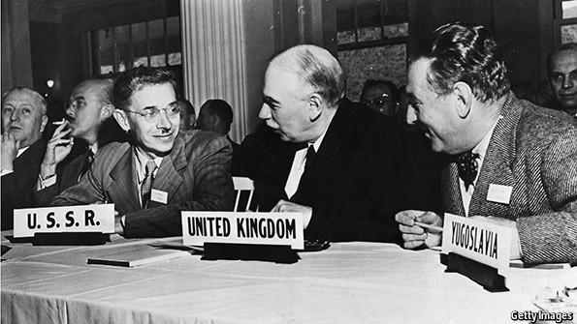
Bretton Woods
After WWII countries wanted to rebuild their economies. Problems: inflation, unemployment, political instability.
44 countries in Bretton Woods, New Hampshire in 1944.
Agreement to renew the gold standard on a modified basis: a dollar-based gold standard
Only the US commited to redeem its currency for gold at the request of a foreign central bank ($35 an ounce of gold).
Other countries pegged the values of currencies to the US dollar. Countries agreed to “support” their exchange rates within + or – 1% of the par values.

Slide 7
In the 1960’s: Dollar seen by the market as “overvalued.” Foreigners become concerned about holding overvalued U.S. dollars at a rate of $35 an ounce.
1971: dollar convertibility into gold was suspended.
December 1971: Smithsonian Agreements
The dollar was devalued against foreign currencies.
The dollar price of gold increased from $35 to $38 an ounce.
Currencies could fluctuate + or – 2.25% around their new par values.
New problems. 1973: generalized floating.

Slide 8
Post - Bretton Woods
Generalized floating for most industrialized countries.
1979 - European Monetary System (EMS)
Fixed but adjustable Exchange Rates: currency bands
ECU: weighted average of participating currencies
1989 – Delors Report: 3 stages until European Monetary Union (EMU) and Single Currency.
1st stage started in July 1990.
Last stage: 1 January 1999 - Exchange rates between European currencies irrevocably fixed. Euro remained a book currency only.
1 January 2002 – Euro notes and coins started to circulate alongside national notes and coins. These were gradually withdrawn

Slide 9
Textbooks classify exchange rate regimes in one of two categories: fixed vs floating. There are more variations.
De facto regimes may be different from De jure regimes.
Hypotheses tested with one type of classification and with the other may yield different results. Different techniques produce different classifications.
Reinhart and Rogoff (2004) classification – statistical analysis of observed exchange rate 1946-2001, 153 countries. They combine official announcements, inflation performance and exchange rate changes and identify 15 de facto ER regimes, distinguishing floating with high inflation from other floating.
Since the 80’s, more than 50% of the jure floats were de facto pegs.
Reinhart, C. M., & Rogoff, K. S. (2004). The modern history of exchange rate arrangements: a reinterpretation. The Quarterly Journal of Economics, 119(1), 1-48.
9

Slide 10
Levy-Yeyati and Sturzenegger (2005) – cluster analysis groups countries into 4 groups: pegged, intermediate, flexible and inconclusive. 1974-2000. All 183 IMF countries.
Pegged regimes – low volatility in exchange rates and high volatility in foreign reserves.
Flexible regimes - high volatility in exchange rates and low volatility in foreign reserves.
Intermediate regimes – medium volatility in exchange rates and medium to high volatility in foreign reserves.
26% of the countries have a de facto regime that is different from the de jure regime
Confirm Calvo and Reinhart's “fear of floating”: many countries that claim to float do not allow their nominal exchange rate to move freely
Levy-Yeyati, E., & Sturzenegger, F. (2005). Classifying exchange rate regimes: Deeds vs. words. European Economic Review, 49(6), 1603-1635.

Slide 11
Current exchange rate arrangements https://www.imf.org/~/media/Files/Publications/AREAER/areaer-2017-overview.ashx

Slide 12
Extreme Fixed with no separate legal tender
Extreme Fixed
Tradi-tional Peg
Crawling Peg
Currency Bands
Dirty (managed)
Clean
Floating exchange rates
Mone-tary Union
Dollarization/ Euroization
Currency Board
12

Slide 13
How to choose the exchange rate regime?
There is no “perfect foreign exchange regime”. It depends on the characteristics of each economy. - Arguments from the theory identifying the recommended regime (fixed or floating) according to certain criteria.

Slide 14
Fixed Exchange Rates
How is parity defended?
The authorities buy or sell foreign currency in exchange for domestic currency.
The authorities impose exchange controls to influence the exchange rate by constricting the demand or supply in the foreign exchange market.
The authorities alter domestic interest rates to influence short-term capital flows, and therefore, the foreign exchange rate .

Slide 15
Buying or selling foreign currency
Defending against depreciation
Buy domestic currency/sell foreign currency.
Corresponds to the financing of a country’s deficit.
The sale of foreign currency decreases the stock of official reserves. If it runs out of reserves, it is possible to borrow from abroad.
The purchase of domestic currency reduces money in circulation: reduces Money Supply.
Defending against appreciation: similar, in the opposite direction.

Slide 16
Assets__________________________________Liabilities____
Domestic Assets Monetary Base
Debt securities Currency in circulation
Loans to Banks Deposits from banks
International Reserve Assets
Foreign-Currency Assets
Central bank Balance Sheet (simplified)
Money Supply = Currency + Deposits from the public in regular banks

Slide 17
Source: Chap. 20 from Pugel.

Slide 18
A temporary external imbalance can be overcome in this way. It is not sustainable to defend a permanent disequilibrium. Costs
Using capital controls
Capital controls are quantity restrictions 
Create inefficiencies,
High administrative costs,
Create incentives to black markets.
Instead of foreign exchange risk concerning the price, there is risk as to the possibility of trading.

Slide 19
Source: Chap. 20 from Pugel.

Slide 20
Changing interest rates
The foreign currency demand and foreign currency supply move.

Slide 21
Trilemma – (Impossible trinity)
One cannot have simultaneously:
Fixed exchange rates
Independent monetary policy
Free capital movements (no capital controls)
21

Slide 22
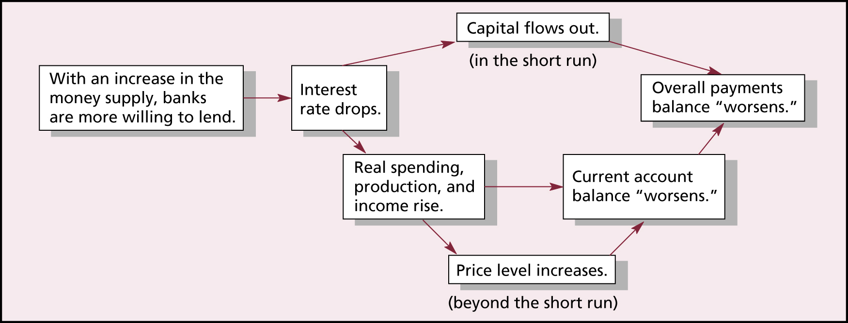
Source: Chap. 23 from Pugel.
Effects of the intervention in the FOREX
Official intervention alters the central bank’s assets and liabilities: the country’s official international reserves and also the Money Supply → impossible to have an independent monetary policy.
Surplus → appreciation pressure on the national currency → intervention: purchase of the foreign currency/sale of the domestic currency → increase in the Money Supply →

Slide 23
Intervention defending the parity helps the country move back towards external balance.
…Problem: the effect of the change in the Money Supply on Prices may not be consistent with the internal balance.
Solution: STERILIZATION.
Surplus → appreciation pressure on the domestic currency → intervention: purchase of the foreign currency/sale of the national currency together with open market operations: purchase of national currency/sale of government bonds.
Money Supply does not change. The only change is the composition of the Central Bank’s assets: more official reserve assets and less domestic assets.

Slide 24
Deficit: similar rationale, in the opposite direction.
Limitations:
Deficit: difficulties in obtaining foreign currency.
Surplus: complaints by other countries about the country’s ongoing surplus, unwillingness of the Central Bank to keep on increasing its holdings of official reserve assets.

Slide 25
Absorption of External Shocks
For exemple, reduction in the demand for our exports.
X – {Y; BPaym } – pressure to depreciation
If Exchange Rate is FIXED: Intervention: {Buy Domestic Currency; Sell Foreign Currency} -  M^{S} -  i - Y
If Exchange Rate is FLOATING : currency depreciates - competitivity increases - X & Imp - Y
Conclusion: Floating exchange rates isolate the economy from external shocks. Fixed exchange rates amplify external shocks.

Slide 26
The choice between fixed and floating depends on the sources of the shocks and on the degree of capital mobility.
Optimal Currency Areas
Mundell (1961)
McKinnon (1963)
Kenen (1969)
The degree of economic integration between countries, the economic size, the cost of adjusting to asymmetric shocks when na independente monetary policy is lost (labour mobility, wage flexibility, fiscal transfers among countries) - criteria to choose the exchange rate arrangement

Slide 27
Credibility argument – Fixed rates induce discipline and make monetary policy more credible (Giavazzi and Pagano 1988)
Trade-off between credibility (associated with fixed exchange rates) and flexibility (associated with flexible exchange rates) – possibly better to choose intermediate regimes.
Questioned by the bipolar view.
Giavazzi, F., & Pagano, M. (1988). The advantage of tying one's hands: EMS discipline and central bank credibility. European Economic Review, 32(5), 1055-1075.

Slide 28
Advantages and Disadvantages of Exchange Rate Regimes
Clean Free Float
Main Advantages
Compatible with an independent monetary policy and with different long term preferences about inflation.
No need for high levels of international reserves.
Not prone to currency crises.
Helps absorb external shocks
Main Disadvantages
Risk of excessive exchange rate volatility - uncertainty.
Discretion in monetary policy may originate inflation bias.

Slide 29
Advantages and Disadvantages of Exchange Rate Regimes
Managed Float
Main Advantages
Compatible with an independent monetary policy and with different long term preferences about inflation.
No need for high levels of international reserves.
Helps absorb external schocks.
Possibility of avoiding excessive volatility,
Main Disadvantages
Uncertainty, lack of transparency.
Discretion in monetary policy may originate inflation bias.

Slide 30
Advantages and Disadvantages of Exchange Rate Regimes
Currency Bands
Main Advantages
Possible adjustment of the exchange rate in accordance with changes in economic circumstances
Transparency
Possibility of avoiding excessive volatility,
Main Disadvantages
Prone to speculative attacks
Difficulty in choosing the band width.
Need of international reserves.
Limited room for monetary policy.

Slide 31
Advantages and Disadvantages of Exchange Rate Regimes
Crawling Peg
Main Advantages
Possible adjustment of the exchange rate in accordance with inflation to keep competitiveness
Smooth adjustment
Transparency
Possibility of avoiding excessive volatility,
Main Disadvantages
Backward-looking adjustment: inflationary inertia.
Forward-looking adjustment;: difficulty in the choice of the inflationary target.
Requirement of international reserves.
Loss of monetary policy autonomy.

Slide 32
Advantages and Disadvantages of Exchange Rate Regimes
Traditional Peg
Main Advantages
Possibility of avoiding excessive volatility,
Allows high inflation countries to reduce inflation by moderating inflationary expectations.
Main Disadvantages
Prone to currency crises.
Requirement of international reserves.
Loss of monetary policy autonomy

Slide 33
Advantages and Disadvantages of Exchange Rate Regimes
Extreme Fixed
Main Advantages
Avoids excessive volatility of exchange rates.
Allows high inflation countries to import credibility in the reduction of inflation.
Not prone to currency crises.
Main Disadvantages
Loss of sovereignty revenue.
(seigniorage).
Loss of monetary policy autonomy.

